Slide 1
ENGR 101 Introduction to Programming Week 14

Slide 2
Reminder Last Week (Week 13) Classes and Methods

Slide 3
class Time: def __init__(self, hour=0, minute=0, second=0): self.hour = hour self.minute = minute self.second = second def __str__(self): return str(self.hour) + ':' + str(self.minute) + ':' + str(self.second) def print_time(self): print str(self.hour) + ':' + str(self.minute) + ':'\ + str(self.second) def time_to_int(self): minutes = self.hour * 60 + self.minute seconds = minutes * 60 + self.second return seconds def int_to_time(self,seconds): hour = (seconds / 3600) % 24 minute = (seconds /60) % 60 second = seconds % 60 return Time(hour, minute, second) def increment(self, seconds): tot_secs = seconds + self.time_to_int() return self.int_to_time(tot_secs) def is_after(self, other): return self.time_to_int() >other.time_to_int()

Slide 4
#Operator overloading def __add__(self, other): seconds = self.time_to_int() + other.time_to_int() return self.int_to_time(seconds) # add time to add time object def add_time(self, other): seconds = self.time_to_int() + other.time_to_int() return self.int_to_time(seconds) # Type-based dispatch def __add__(self, other): if isinstance(other, Time): return self.add_time(other) else: return self.increment(other) # Right side addition def __radd__(self, other): return self.__add__(other)

Slide 5
Week 14 Inheritance

Slide 6
Car Dealership
Imagine we run a car dealership!
Selling all types of vehicles from trucks to motorcycles.
Vehicle price: $5000 x num_of_wheels
Buying back a car: flat_rate – 10% of kilometers
flat_rate = 10,000 for trucks
flat_rate = 8,000 for cars
flat_rate = 4,000 for motorcycles

Slide 7
Car Dealership
Design an object oriented sales system for the dealership!
What would be the objects?
Car, Truck, Motorcycle
Sale, Customer, Inventory, …

Slide 8
Dealership - Car Class
class Car:
wheels = 4 def __init__(self, kilometers, make, model, year): """Return a new Car object.""" self.kilometers = kilometers self.make = make self.model = model self.year = year def sale_price(self): """Return the sale price for this car.""" return 5000 * self.wheels def purchase_price(self): """Return the price for which we would pay to purchase the car.""" return 8000 - (0.10 * self.kilometers)

Slide 9
Dealership - Truck Class
class Truck:
wheels = 10 def __init__(self, kilometers, make, model, year): """Return a new Truck object.""" self.kilometers = kilometers self.make = make self.model = model self.year = year def sale_price(self): """Return the sale price for this truck""" return 5000 * self.wheels def purchase_price(self): """Return the price for which we would pay to purchase the truck.""" return 10000 - (0.10 * self.kilometers)

Slide 10
Dealership - Motorcycle Class
class Motorcycle:
wheels = 10 def __init__(self, kilometers, make, model, year): """Return a new Truck object.""" self.kilometers = kilometers self.make = make self.model = model self.year = year def sale_price(self): """Return the sale price for this truck""" return 5000 * self.wheels def purchase_price(self): """Return the price for which we would pay to purchase the truck.""" return 4000- (0.10 * self.kilometers)

Slide 11
Problems?
Any problems so far?
The two classes are almost identical!
DRY (Don’t Repeat Yourself!)
Solution:
Inheritance!: Introduce base class that will capture the shared parts of Car and Truck classes
Add Vehicle class as our base class
Derive Car, Truck and Motorcycle classes from Vehicle

Slide 12
Dealership – Vehicle Class
class Vehicle:
flat_rate = 0
wheels = 0 def __init__(self, kilometers, make, model, year): """Return a new Vehicle object.""" self.kilometers = kilometers self.make = make self.model = model self.year = year
def sale_price(self): return 5000 * self.wheels def purchase_price(self): return self.flat_rate - (0.10 * self.kilometers)
def vehicle_advertisement_text(self):
pass
Our “base” class that accommodates the shared parts

Slide 13
Inheritance: Car and Truck
class Car(Vehicle):
flat_rate = 8000
wheels = 4
def vehicle_advertisement_text (self):
return 'Car - ' + str(self.year) + ' ' + self.make + ' ' + \
self.model + ' - ' + str(self.kilometers) + ' km'
class Truck(Vehicle):
flat_rate = 10000
wheels = 10
def vehicle_advertisement_text (self):
return ‘Truck - ' + str(self.year) + ' ' + self.make + ' ' + \
self.model + ' - ' + str(self.kilometers) + ' km'
Syntax for inheritance
Method overriding

Slide 14
Adding a new class: Motorcycle
class Motorcycle(Vehicle):
flat_rate = 4000
wheels = 2
def vehicle_advertisement_text (self):
return Motorcycle - ' + str(self.year) + ' ' + self.make + ' ' + \
self.model + ' - ' + str(self.kilometers) + ' km'

Slide 15
Problems?
Did we solve all problems?
Not quite! The following method still looks very similar and being repeated in different child classes.
vehicle_advertisement_text
Solution:
Move the common/repeated part to the base class under vehicle_advertisement_text method.
Call base class’es vehicle_advertisement_text method in child classes’ vehicle_advertisement_text method.

Slide 16
class Vehicle(object): ...
...
...
def vehicle_advertisement_text(self): return str(self.year) + ' ' + self.make + ' ' + \ self.model + ' - ' + str(self.kilometers) + ' km'
Move the common parts to the base class method
Inherit the built-in object class
Call base class method in child classes
class Car(Vehicle): flat_rate = 8000 wheels = 4 def vehicle_advertisement_text (self): return 'Car - ' + super(Car, self).vehicle_advertisement_text() class Truck(Vehicle): flat_rate = 10000 wheels = 10 def vehicle_advertisement_text (self): return 'Truck - ' + super(Truck, self).vehicle_advertisement_text() class Motorcycle(Vehicle): flat_rate = 4000 wheels = 2 def vehicle_advertisement_text(self): return 'Motocycle-' + super(Motorcycle, self).vehicle_advertisement_text() car = Car(70000, 'Toyota', 'Corolla', 2008) print car.vehicle_advertisement_text()

Slide 17
Inheritance - Thoughts
Inheritance is a useful feature.
Inheritance can facilitate code reuse, since you can customize the behavior of parent classes without having to modify them.
Inheritance can make programs difficult to read. When a method is invoked, it is sometimes not clear where to find its definition. The relevant code may be scattered among several modules.

Slide 18
Animal World
class Cat:
def __init__(self, name):
self.name = name
class Dog:
def __init__(self, name):
self.name = name

Slide 19
Talking Animals
animals = [Cat('Missy'),
Cat('Mistof'),
Dog('Lassie')]
for animal in animals:
if isinstance(animal, Cat):
print animal.name + ': ’ + ‘Meow’
elif isinstance(animal, Dog):
print animal.name + ': ’ + ‘Woof’
# output:
# Missy: Meow!
# Mistof: Meow!
# Lassie: Woof!

Slide 20
Problem?
What if we have 1000 different kinds of animals rather than just Cat and Dog?
1000 elif statements?

Slide 21
Solution: Polymorphism
class Animal(object):
def __init__(self, name):
self.name = name
def talk(self):
return ‘what?’
class Cat(Animal):
def talk(self):
return 'Meow!'
class Dog(Animal):
def talk(self):
return 'Woof!'

Slide 22
Solution: Polymorphism
animals = [Cat('Missy'),
Cat('Mistof'),
Dog('Lassie')]
for animal in animals:
print animal.name + ': ' + animal.talk()
# output:
#
# Missy: Meow!
# Mistof: Meow!
# Lassie: Woof!

Slide 23
Polymorphism
Functions that can work with several types are called polymorphic.
Polymorphism can facilitate code reuse.
For example, the built-in function sum, which adds the elements of a sequence, works as long as the elements of the sequence support addition.

Slide 24
Polymorphism
Since Time objects provide an add method, they work with sum:
t1 = Time(7, 43)
t2 = Time(7, 41)
t3 = Time(7, 37)
total = sum([t1, t2, t3])
print total
23:1:0
print sum([1, 2, 3])
6

Slide 25
Polymorphism
vehicle_advertisement_text() method in Vehicle, Car, Truck, Motorcycle classes is another example of polymorphism that we worked with as it worked for different objects.
Another example:
def histogram(s): d=dict() for c in s: if c not in d: d[c]=1 else: d[c]=d[c]+1 return d my_string="banana" my_list=["spam","egg","spam","spam","bread"] my_tuple=("a","b","c","b","a","a","a","d") #Histogram is a polymorphic function because it works for different types: # strings, lists, tuples and even dictionaries. print histogram(my_string) print histogram(my_list) print histogram(my_tuple)

Slide 26
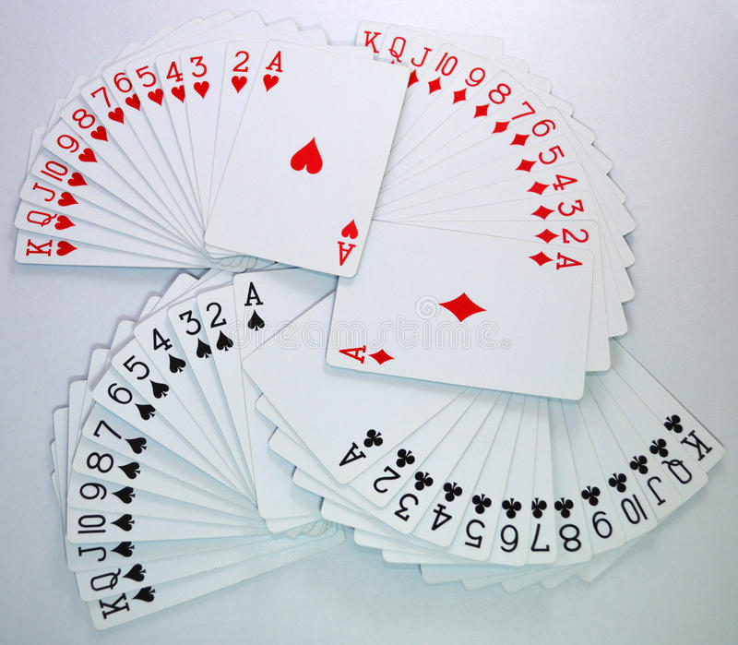
Modeling Card Objects
Hearts
Diamonds
Clubs
Spades
A deck of cards

Slide 27
Card objects
There are fifty-two cards in a deck, each of which belongs to one of four suits and one of thirteen ranks.
The suits are Spades, Hearts, Diamonds, and Clubs (in descending order).
The ranks are Ace, 2, 3, 4, 5, 6, 7, 8, 9, 10, Jack, Queen, and King.
Depending on the game that you are playing, an Ace may be higher than King or lower than 2.

Slide 28
Class attributes
class Card(object): """represents a standard playing card.""" suit_names = ['Clubs', 'Diamonds', 'Hearts', 'Spades'] rank_names = [None, 'Ace', '2', '3', '4', '5', '6', '7', '8', '9', '10', 'Jack', 'Queen', 'King'] def __init__(self, suit=0, rank=2): self.suit = suit self.rank = rank
def __str__(self):
return Card.rank_names[self.rank] + ‘ of ’ + \
Card.suit_names[self.suit]

Slide 29
Comparing cards – Operator Overloading
For built-in types, there are relational operators (<, >, ==, etc.) that compare values and determine when one is greater than, less than, or equal to another.
For user-defined types, we can override the behavior of the built-in operators by providing a method named __cmp__.
__cmp__ takes two parameters, self and other, and returns a positive number if the first object is greater, a negative number if the second object is greater, and 0 if they are equal to each other.

Slide 30
Comparing cards – Operator Overloading
# inside class Card: def __cmp__(self, other): # check the suits if self.suit > other.suit: return 1 if self.suit < other.suit: return -1 # suits are the same... check ranks if self.rank > other.rank: return 1 if self.rank < other.rank: return -1 # ranks are the same... it's a tie return 0

Slide 31
Comparing cards
You can write this more concisely using tuple comparison: # inside class Card: def __cmp__(self, other): t1 = self.suit, self.rank t2 = other.suit, other.rank return cmp(t1, t2)

Slide 32
Decks
We have Cards, lets define a Deck of cards.
class Deck(object): def __init__(self): self.cards = [] for suit in range(4): for rank in range(1, 14): card = Card(suit, rank) self.cards.append(card)

Slide 33
Printing the Deck
#inside class Deck: def __str__(self): res = [] for card in self.cards: res.append(str(card)) return '\n'.join(res)
deck = Deck()
print deck
Ace of Clubs
2 of Clubs
3 of Clubs
...
10 of Spades
Jack of Spades
Queen of Spades
King of Spades

Slide 34
Add, remove, shuffle, and sort
To distribute cards, we need a method that removes a card from the one end of the deck and returns it.
The list method, “pop”, provides a convenient way to do that: #inside class Deck: def pop_card(self): return self.cards.pop()

Slide 35
Add, remove, shuffle and sort
To add a card, we can use the list method append: #inside class Deck: def add_card(self, card): self.cards.append(card)

Slide 36
Add, remove, shuffle and sort
Lets define method to shuffle cards: using the function shuffle from the random module: # inside class Deck: def shuffle(self): random.shuffle(self.cards)

Slide 37
Inheritance - Parent/Child
Inheritance is the ability to define a new class that is a modified version of an existing class.
It is called “inheritance” because the new class inherits the methods and attributes of the existing class. Extending this metaphor, the existing class is called the parent and the new class is called the child.
As an example, let’s say we want a class to represent a “hand,” that is, the set of cards held by one player.

Slide 38
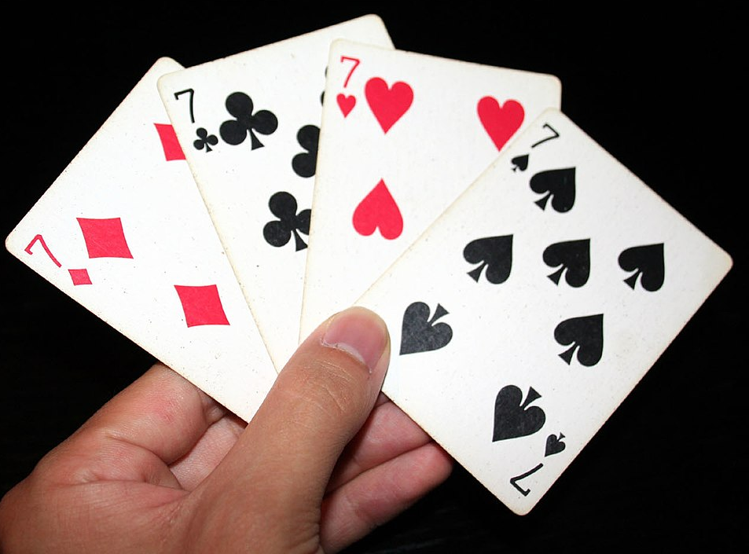
Inheritance – Similar/Different
A hand is similar to a deck:
both are made up of a set of cards, and both require operations like adding and removing cards.
A hand is also different from a deck;
there are operations we want for hands that don’t make sense for a deck, e.g., comparison.
This relationship between classes —similar, but different— lends itself well to inheritance.

Slide 39
Inheritance - Declaration
The definition of a child class is like other class definitions, but the name of the parent class appears in parentheses: class Hand(Deck): """represents a hand of playing cards"""
This definition indicates that Hand inherits from Deck; that means we can use methods like pop_card and add_card for Hand objects as well as Deck objects.

Slide 40
Inheritance - Overriding
Hand also inherits __init__ from Deck, but it doesn’t do what we want: instead of populating the hand with 52 new cards, the init method for Hands should initialize cards with an empty list.
If we provide an init method in the Hand class, it overrides the one in the Deck class: # inside class Hand: def __init__(self, label=''): self.cards = [] self.label = label

Slide 41
Inheritance - Overriding
So when you create a Hand, Python invokes this init method:
hand = Hand('new hand')
print hand.cards []
print hand.label new hand

Slide 42
Inheritance
But the other methods are inherited from Deck, so we can use pop_card and add_card to deal a card:
deck = Deck()
card = deck.pop_card()
hand.add_card(card)
print hand King of Spades

Slide 43
Deal a hand
#inside class Deck: def move_cards(self, hand, num): for i in range(num): hand.add_card(self.pop_card())

Slide 44
Exercise
Write a Deck method called deal_hands that takes two parameters, the number of hands and the number of cards per hand, and that creates new Hand objects, deals the appropriate number of cards per hand, and returns a list of Hand objects.

Slide 45
Deal a hand
#inside class Deck: def deal_hands(self, hand_num, card_num):
hands = [] for i in range(hand_num):
hand = Hand(‘hand ’ + str(i)) self.move_cards(hand, card_num)
hands.append(hand)
return hands

Slide 46
Exercises

Slide 47
Exercise 1:
Write a class Game with attributes:
energy,
money and
no_of_castles
and a show_info (which will print the attributes’ values) method.
Write a class named Player that will inherit from Game class and implement a create_new_castle method
which will allow the player to create a new castle if his energy is >5 and his money is > 10, it should update the attributes accordingly.

Slide 48
Exercise 2:
Create another class OponentPlayer that will inherit from class Game written before and it will have an additional attribute named no_of_destructions.
Implement a method that will destroyCastle() which will allow the player to destroy a castle, thereby increasing his no_of_destructions attribute.
If the player’s energy is lower than 10, he won’t be able to destroy the castle.
Attributes should be updated properly following destruction.

